Slide 1


KARABÜK UNIVERSITY TURKISH TEACHING APPLICATION AND RESEARCH CENTER
ORIENTATION PRESENTATION

Slide 2

LIVING AND ADAPTING IN A NEW COUNTRY
Today, people migrate to different countries for reasons such as natural disasters, famine, war, work, education, and different lifestyles. This situation has brought about different difficulties for both migrants and migration areas.
-The most important problems faced by migrants are different customs and traditions, law, language and religion. In this case, the best solution is to implement ways of living together with the society in the host country without conflict or exclusion.

Slide 3

Students enrolled in Karabük University TÖMER should pay attention to the following points in order to adapt to the society:
Applying to official and reliable places to get the information needed,
Learning Turkish at a good level,
Taking the necessary trainings,
Learning their own rights and responsibilities and behaving accordingly,
Being honest in every statement he/she makes to official institutions and his/her environment,

Slide 4
Not to offer bribes, gifts and tips to people in the institution,
Submitting the documents requested by the institutions for all kinds of processes in full and on time,
Not to give his/her identity card or documents to anyone else, not to use someone else's documents in various services on his/her behalf,
Complying with the application deadlines,
Obeying the rules of society, staying away from behaviours that disturb others,

Slide 5
-Keeping public places and the place where he/she lives clean, not disturbing others,
Using public property carefully and not to damage it,
Avoiding all forms of violence,
Being careful against those who try to defraud him/her with the promise of helping him/her and facilitating the procedures, even if he/she is a citizen of his/her own country,
Not to pay any fees to other persons other than the landlord and the real estate agent in the lease contracts,

Slide 6
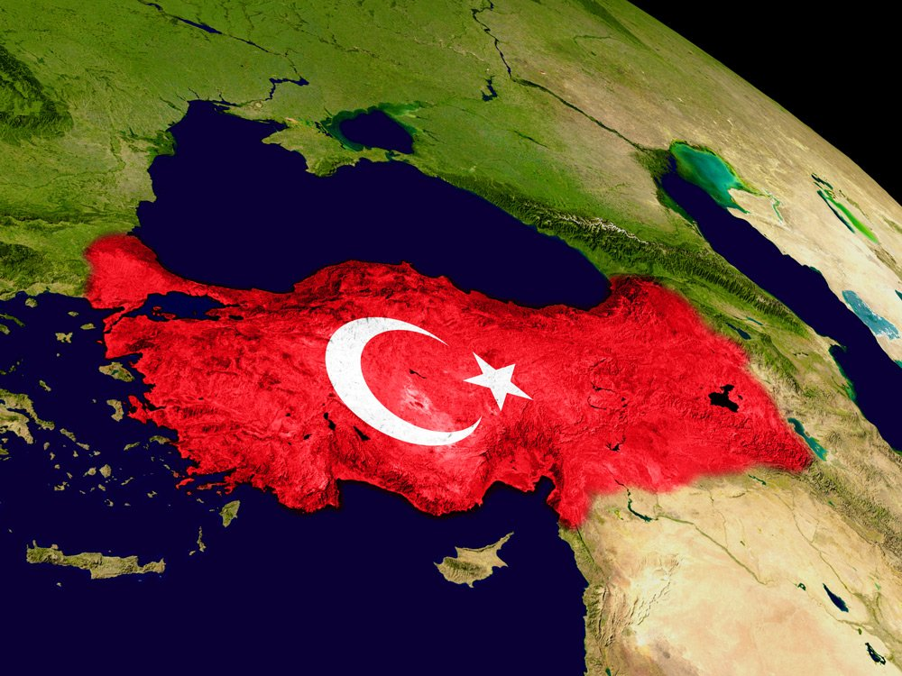
THE TOPOGRAPHY OF TÜRKİYE
Türkiye is a country located in the middle latitudes of the northern hemisphere 97% of Türkiye is located in Asia and 3% in Europe. It has the Bosphorus and Dardanelles separating Asia and Europe. Türkiye is a peninsular country surrounded by seas on three sides with an area of 814.576 km2.
According to 2023, Türkiye has a population of 85.372.377 people.(* taken from Turkish Statistical Institute. (tuik.gov.tr).

Slide 7
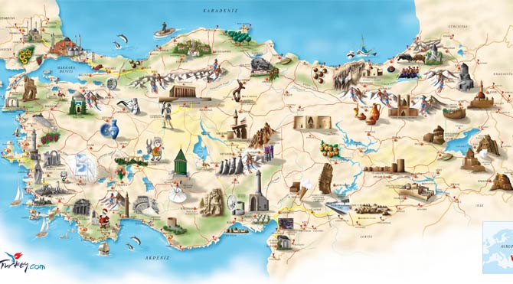
Türkiye's Cultural Structure, Traditions and Customs
Turkish Language and Features
The official language of the Republic of Türkiye is Turkish. Turkish is one of the oldest and deep-rooted languages of the world. The first traces of Turkish are found 4500-5000 years ago. There are 168 common words between Sumerian, the language of the world's first known civilisation, and Turkish.
Turkish was spoken in a wide geography from Hungary to China and from Siberia to Egypt.
Turkish is an agglutinative language. There is a fixed root and suffixes to this root. In Turkish, roots do not change according to gender and time. Vocal harmony is important in Turkish. This is an important factor that provides harmony.

Slide 8
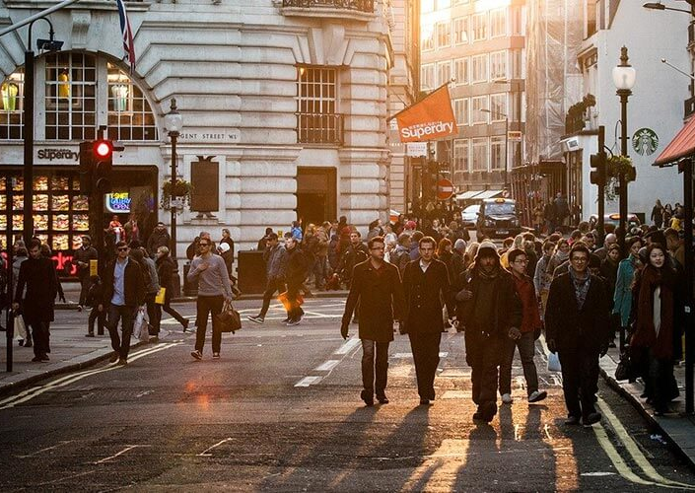
GENERAL MORALITY AND SOCIAL LIFE RULES
Rules of daily life
In social life, there are rules that people must obey in their relations with each other. Living in accordance with these rules will ensure the formation of relationships based on respect, courtesy and tolerance in society. Some rules of courtesy.

Slide 9
General rules of courtesy
Expressions such as could you please, please, thank you are a sign of courtesy.
You should not speak loudly in crowded environments.
You should not wait or sit in a way that prevents others in common areas such as roads, bridges, parks, squares, places of worship, hospitals.
Public toilets should be kept clean.
You should not litter on roads, parks and picnic areas.
The elders, the disabled, pregnant women and children should be given priority when getting on and off vehicles.

Slide 10
Rules to be obeyed in Official Institutions
If the institution has an appointment system, an appointment should be made before going and the appointment time should not be missed.
Working hours of public institutions must be observed. This is usually from 8.00 to 17.00. 12.30 p.m. - 13.30 p.m. is usually a lunch break.
In some institutions, a queue number may be required to make transactions.
-Making noise or talking loudly on the phone while waiting in queues is frowned upon.

Slide 11
Officers who will be assisting should be listened to carefully and should not be interrupted. The attendant should not be unnecessarily occupied.
-It is forbidden to offer gifts, gratuities or bribes to an official to get the work done.
It is not appropriate to ask for things contrary to the legislation and to insist on them.

Slide 12

Rules to be obeyed in Public Living Areas
Neighbourhood relations are important in Türkiye. In order for this relationship to be healthy, some rules must be followed. We can summarise them as follows:
-Since the hours between 23.00 - 08.00, Sundays and public holidays are legal resting hours in our country, it is not correct to listen to loud music, to operate machines that can make noise such as washing machines and vacuum cleaners.
-Since the balconies of the house are private areas of use, it is not correct to shake out products such as carpets, rugs and tablecloths.

Slide 13
-Items such as slippers, lockers, rubbish should not be kept in front of the entrance door of the house.
-Home privacy should be respected and the curtains of the house should be closed so that they do not show inside.
-Do not open the door to unknown persons without taking precautions.

Slide 14

RIGHTS AND OBLIGATIONS STATUS, RIGHTS AND OBLIGATIONS OF FOREIGNERS IN TÜRKİYE (FREQUENTLY ASKED QUESTIONS)
How can I access the address information and telephone numbers of the provincial directorates of migration administration?
-It is available on the official website of the General Directorate of Migration Management under the heading ‘provincial organisation’ in the communication section.(www.goc.gov.tr)

Slide 15
I transferred from university A to university B or I won university B. What is the procedure I should follow?
-In case of a change of faculty or department in the same educational institution and a change of educational institution in the same province, the existing residence permit remains valid provided that the education is not interrupted and the person notifies in due time. These persons must notify the change of department / faculty / school within 20 working days.
-If the residence permit is shorter than the duration of education, it is extended for the duration of education from the date of expiry of the permit. If the education will be continued in a different province, the existing residence permit is cancelled and a residence permit is issued for the new education period.

Slide 16
How many days are given for missing documents?
30 days can be given. If not completed within this period, the application will be invalid.
How long should my passport be for my residence permit application?
Have a document with a duration of at least 60 days longer than the requested period.

Slide 17
I have changed my address during my current residence permit period. What should I do?
If it is within the borders of the same province, it must be notified to the provincial immigration administration within 20 working days.
When is it necessary to apply for the extension of an existing residence permit?
Applications for extension must be submitted before the expiry of the residence permit in all circumstances, starting 60 days before the expiry of the residence permit.

Slide 18
I graduated long before my student residence permit expired. Will my residence permit continue and how should I proceed?
-Residence permits of students who graduate are cancelled as of the date of graduation and they must apply for a residence permit suitable for the new purpose of stay within ten days. The residence permit of the student who cannot graduate within the normal education period is extended for a maximum period of one year and not exceeding the maximum education period.

Slide 19
What should I do when I change my passport?
-Passport changes must be notified to the Provincial Directorate of Migration Management within 20 working days.

Slide 20
I have enrolled in a Turkish learning course. What are the procedures for a residence permit?
Turkish language course visa in case of direct enrolment in a Turkish language learning course or short-term residence permit in case of arrival with a study visa. This permit can only be granted 2 times.
If you are enrolled in a university and referred to TÖMER by your university, a student residence permit is issued until the next academic year, provided that you document your situation. Visiting students who have a visa for study purposes and who are not enrolled in the university because their Turkish language level is not sufficient and who are directed to a Turkish language learning course may be granted a short-term residence permit for those who meet the conditions.

Slide 21
Are open education students granted a residence permit?
-Student residence permit is not issued on the grounds of special student, open education or distance education.

Slide 22
Requirements for Accessing University Dining Services
In order to dine at our university cafeterias, students must first become a customer of Yapı Kredi Bank. This can be done quickly and easily through an online meeting via Yapı Kredi Mobile Banking or by visiting a Yapı Kredi branch.
Our international students can open a bank account by visiting the designated section for them at Yapı Kredi Bank branches.
Click here for detailed information on how to become a Yapı Kredi customer:
Microsoft PowerPoint - Yap1 Kredi Mobil ile Müşteri Olma.pptx

Slide 23
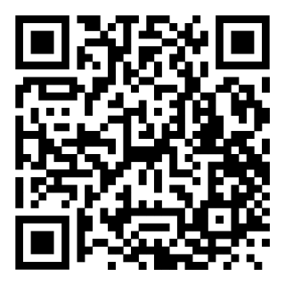
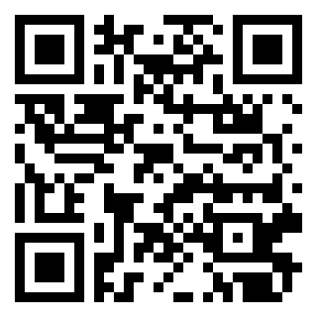


After becoming a Yapı Kredi customer, the Yapı Kredi Mobile and/or World Mobile applications should be downloaded to your smartphone via the links below or by scanning the QR codes.
After logging into the application, the e-Campus feature must be activated.

Slide 24
e-Campus Activation and Limit Definition:
Select "Mobile Payment Settings" under the “PAY” menu.
2. Select the "E-Campus Activation" section. You can view your registered digital card in this section.
3. You can proceed with the process and complete it by selecting the "Set Limit" button.
During the activation process, a payment method will be defined. You may designate your Yapı Kredi credit cards, debit cards, or account as a payment method. In order to do so, you must first open a credit card, debit card, or bank account.

Slide 25
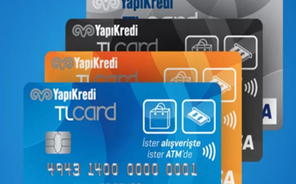
How is the payment process carried out?
The payment transaction can be carried out using two different methods:
1. You can complete your payment using the contactless feature of your Yapı Kredi card. To pass through the turnstile using the contactless feature of your Yapı Kredi card, simply hold your card near the card reader located on the turnstile. If there is sufficient balance, the contactless payment will be processed, and you will be allowed to proceed through the turnstile.
VEYA
2. Open the Yapı Kredi Mobile or World Mobile application. After tapping the “PAY” button, select the “Pay with QR Code” option. Scan the QR code on the turnstile using the camera that opens.

Slide 26
Click here for detailed information regarding the activation process!
E-Campus Usage Steps!
E-Campus Information Document!
You will not be able to make a payment if your digital card has no available balance.

Slide 27
INFORMATION ON SOCIAL LIFE HOUSING AND INFRASTRUCTURE SERVICES HOUSING, RENTING AND ACQUIRING PROPERTY IN TÜRKİYE
-In Türkiye, as in many countries, you can buy or rent a house. According to the Constitution, the dwelling is inviolable and no one may enter it without permission. The exception to this is for security reasons or with a court order.
When settling in a dwelling, you must have a subscription for electricity, water, optional natural gas and telephone connections. For this you have to do it personally in your own name.

Slide 28
HOUSING RENTAL AND PROPERTY OWNERSHIP IN TÜRKİYE
The place where people reside for the purpose of staying permanently is called a residence / settlement (domicile). Everyone, including foreigners living in Türkiye, must have a residence / dwelling registered in the address system. According to the laws in Türkiye, no one can enter the dwelling / settlement without the permission of the resident. They can only be entered for security reasons or with a court order.

Slide 29
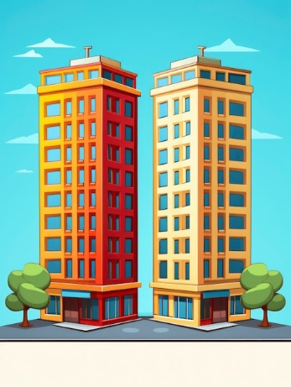

House Types
Apartment Detached

Slide 30
Leasing Transactions - Contract Transactions
In Türkiye, as in many other countries, it is possible to live by buying or renting a house. A person who rents a house (residence) or a workplace enters into a lease agreement with the owner (lessor). The other name of this agreement is a contract. The contract secures the rights of both the tenant and the owner. The contract (lease agreement) must be made in writing. It is signed in duplicate between the tenant and the lessor. One copy of the contract must be in the tenant and the other copy in the landlord.

Slide 31
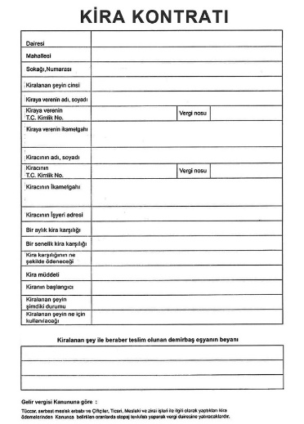
ATTENTION!!!
The information that should be included in the lease agreement is as follows:
Identity informations of the parties
Informations about the rented place (Street, Avenue, Street, Door no.)
Start date and duration of the Lease Agreement
Rent price and payment method
Condition and use of the leased place
Leased and given fixtures, if any

Slide 32
The lessor (owner) decides the duration of the lease. When the lease expires, the contract can be renewed for a year. If the tenant does not want to renew the contract, he notifies the owner in writing 15 days before the end date of the contract. If the lease contract is to be renewed, the landlord and the tenant decide together whether there will be a rent increase. Rent cannot be increased randomly. The rate of increase cannot exceed the rate of increase in the producer price index of the previous year. The tenant must pay the rent regularly.

Slide 33
The tenant must receive a receipt or a signed document of payment. If the tenant does not pay the rent for two or more months in a year, the landlord has the right to apply to the court to evict the tenant. The landlord cannot force the tenant to leave the property without a court order. The landlord cannot enter the house without the tenant's permission. However, he/she may enter with the tenant's permission at a time to be agreed in advance with the tenant regarding the maintenance and repair of the house, shop. In leasing transactions, care should be taken whether the leased property has been rented to other persons before.

Slide 34
Subscription Transactions
It is compulsory to obtain a subscription for electricity, water, and optionally natural gas and telephone connections when settling in a residence or workplace. Everyone who moves into a new residence, whether by buying or renting, does these works personally or by power of attorney.

Slide 35
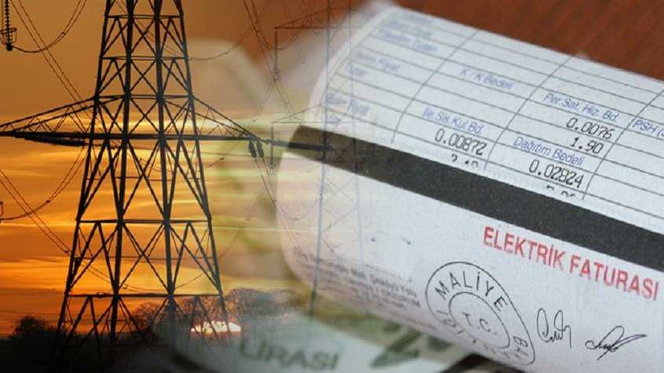
Electricity Application
-In order to connect electricity, it is necessary to apply to an electricity sales and distribution company with the required documents. Electricity subscription transactions in Karabük are made to Enerjisa. The following documents are requested during the application:
National identity card (If you are a tenant, T.C. identity number of the landlord)
Installation or meter serial number
Security fee
With DASK policy number
-In order to perform your subscription transactions faster, you can make an appointment online via Enerjisa Karabük Customer Services Centre Online Transactions or call the Call Centre at 444 4 372.

Slide 36
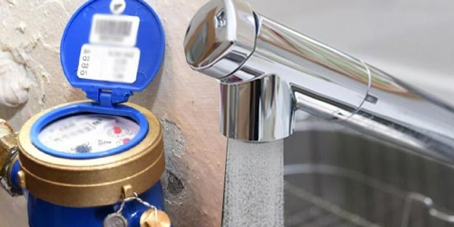
Water Application
Those living in the metropolitan municipality should apply to the metropolitan municipality, and those living in other settlements should apply to the water and sewerage services directorates of the relevant municipality. Karabuk Water Subscription Transactions are carried out by Karabük Municipality Water and Sewerage Transactions unit with the necessary documents.

Slide 37
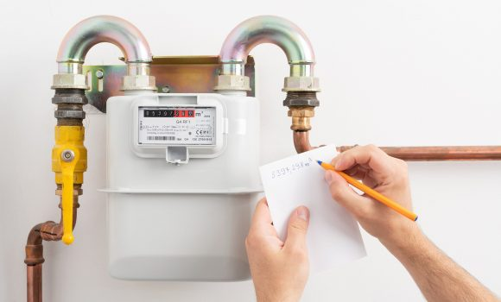
Natural Gas Application
Natural gas distribution service in Karabük is carried out by KarGaz. In order to obtain an individual subscription, the homeowner can apply with a photocopy of the identity card and title deed, and the tenant can apply with a photocopy of one of the documents showing that they benefit from the lease contract, electricity, water and environmental cleaning services.

Slide 38

Telephone, Cable Broadcasting, Internet Application
Applications for telephone and internet connection to homes are made to Türk Telekom regional directorates. During the application, it is sufficient to show the foreigner identity document or a photocopy of it to the official.

Slide 39
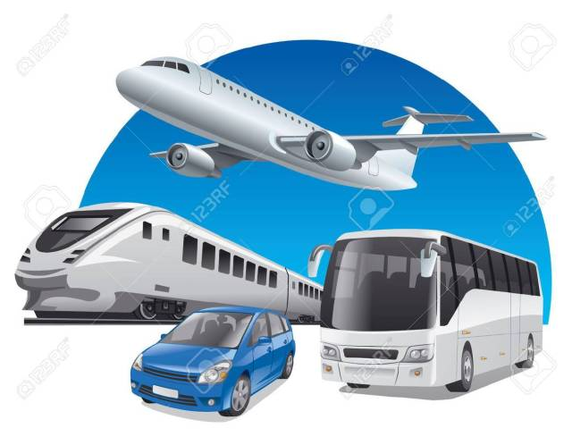
INTERCITY AND INTRA-CITY TRANSPORT

Slide 40
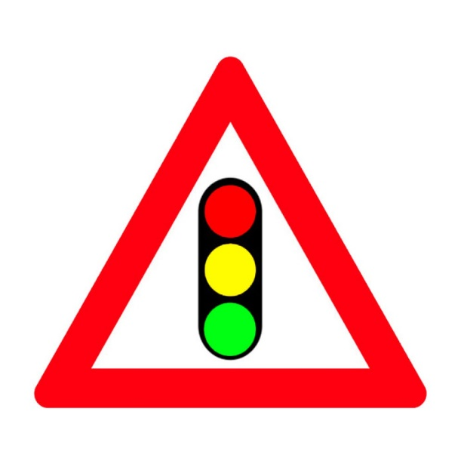
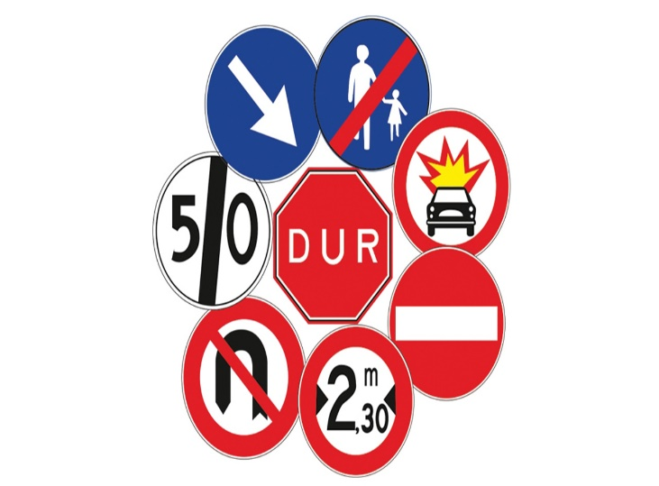
Domestic and International Travelling
Foreigners in Türkiye can travel anywhere in the country. However, persons with temporary and international protection status must have a passport or an official document with them in order to go to another city from the city they are in.
General Traffic Information
In Türkiye, traffic flows on the right. The left lane can only be used to pass the vehicle in front. Pedestrians should first look to the left and then to the right when crossing the road. Seat belts must be worn while travelling. It is forbidden to drink and drive. The specified rules must be followed. Otherwise, penal sanctions are applied.

Slide 41
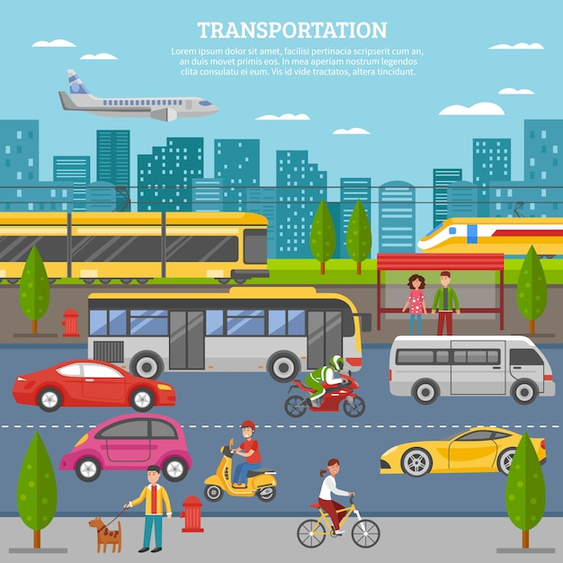
Public Transport
The most common form of public transport in Türkiye is bus transport between cities and within cities. Travelling by public transport is cheaper and safer. Land transport is widespread in public transport in Karabük. Land transport is carried out by buses, intercity trains, high speed trains and minibuses, municipal buses and private public buses in the city.
Certain Points to Consider While Travelling
Do not smoke in public transport and do not take off your shoes. Bags and other personal belongings should be kept for personal safety. Everyone is required to carry an identity document (passport) while travelling in Türkiye.

Slide 42
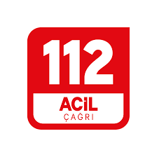
EMERGENCY NUMBERS

Slide 43

You can call the 112 emergency line for emergencies (heart attack, shortness of breath, drowning, accidents, poisoning, injury and falling from height, fire, etc.) from anywhere in our country.Calls to 112 emergency line are free of charge. Callers to emergency call centres are automatically located.
There is also a Foreigners Communication Centre (YİMER) for foreigners in Türkiye.You can contact YİMER 157, the Provincial Directorate of Migration Management or law enforcement agencies (police, gendarmerie) to ask for help in all kinds of emergencies that threaten the safety of property and life, such as forced labour and forced prostitution, human trafficking, unofficial marriages, organ trafficking, migrant smuggling, fraud, forgery, non-payment of labour wages, theft, extortion.

Slide 44
YİMER 157, which serves as an information line between 08:00-18:00 on weekdays, also responds to the questions of foreigners in Türkiye within the scope of the legislation of the Directorate of Migration Management such as visa, residence permit, international protection, temporary protection.YİMER provides services in 5 languages (Turkish, English, Russian, Arabic and Persian).
ATTENTION!!!
For accurate, fast and reliable information, you can reach YIMER 157 from within the country by phone number 157 and from abroad by phone number +90 312 157 11 22. In addition, YİMER 157 can be reached via www.yimer.gov.tr website, Instagram, Twitter, Facebook social media channels, web chat, WhatsApp line +90 312 422 04 00 and @Yimer157bot telegram channel.

Slide 45
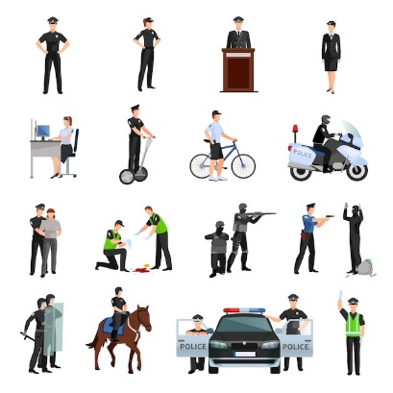
SECURITY FORCES
A person who is a victim or witness of a crime, or who is in a dangerous situation, or who sees a dangerous situation, should go to the nearest police station or call ‘112’ They can ask for help by calling the Emergency Call Centre.
The Gendarmerie Organisation is one of the law enforcement agencies authorised to use weapons to ensure security and public order.
Within the municipal boundaries of provinces and districts, the police are in charge and authorised. However, some small districts do not have a police organisation. In these districts, the gendarmerie is in charge and authorised.

Slide 46
RELIGIOUS SERVICES
Places of Worship
Buildings specialised for worship are called ‘temple’. People want to fulfil their worship in accordance with their beliefs. Türkiye offers everyone various opportunities to fulfil this need. Muslims worship in mosques and masjids, Christians in churches or chapels and Jews in synagogues. Religious services for Muslims in Türkiye are carried out by the Directorate of Religious Affairs and its provincial and district mufti offices.

Slide 47
Funeral Services
Funeral services are an important part of religious services. When a person dies, there are some legal procedures that must be carried out. These procedures are as follows: Obtaining a death and burial permit, preparing the body for burial, transporting the body, burying the body, reporting the death to the registry office. In Türkiye, the municipality is responsible for these funeral procedures. Therefore, funeral procedures are carried out by applying to the municipality where the person died. Municipalities provide funeral services 24 hours a day, 365 days a year. In the death of foreign nationals in Türkiye, the same procedures in the death of turkish nationals are applied.

Slide 48
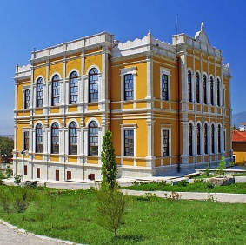
SOCIAL-SPORT FACILITIES
Karabük also offers an alternative for you to spend your free time and socialise
Türkiye is a unique country with numerous museums and exhibition halls in 81 provinces. There are also many museums in Karabük.

Slide 49
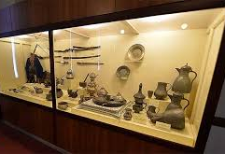
You can visit museums such as City History Museum, District Governors Museum House, Coffee Museum, Turkish Delight and Saffron Museum in Karabük. In this sense, Karabük hosts many local and foreign tourists.

Slide 50

Cinema
Within the framework of its role in the cinema sector, Karabük also hosts cinema organisations. The most popular of these is the Golden Saffron Film Festival held every year.
In addition to film festivals, movie theatres in the shopping malls in the centre of Karabük and Safranbolu make it easy to follow the films.

Slide 51
Sport
The Ministry of Youth and Sports, which is organised in 81 provinces, and many federations and sports clubs are working to develop sports. You can check the ‘Weekly Sports Activity Programme’ on the website of Karabük Provincial Directorate of Youth and Sports, which operates in Karabük, and you can access current developments in the sports branch of interest, information about clubs and various opportunities to do sports. In addition, announcements about related subjects can be followed on the website of Karabük University Health, Culture and Sports Department.

Slide 52

BANK TRANSACTIONS
Banks that are related to the daily life of the people are deposit banks and participation banks. Two types of deposit accounts, demand deposit and time deposit accounts, can be opened in deposit and participation banks.
Opening a Bank Account
In order to open an account at any bank, you must be over 18 years of age (of legal age) and have a valid identity document. Persons under the age of eighteen can also open a bank account. However, they must be accompanied by a person over the age of 18. All foreigners who fulfil these conditions can also open an account in the bank of their choice. However, in order for foreigners to open a bank account, they must have one of the following documents indicating their identity :

Slide 53
Passport,
Residence Certificate,
International Protection Applicant Certificate,
International Protection Status Holder Identity Document,
Stateless Person Identity Document,
Temporary Protection Identity Document

Slide 54

Money Transfer
To send money from one bank account to another bank account, it is necessary to make a wire transfer or EFT transaction. Sending money from one bank account to another account in the same bank is called wire transfer; sending money from one bank account to an account in a different bank is called EFT (electronic fund transfer). Banks charge a certain fee for their wire transfers and EFT transactions. In order to make a wire transfer or EFT transaction, the bank account number or IBAN number of both the sender and the recipient is required. However, it is not enough to know the account number and IBAN for money transfers to other countries or from other countries to Türkiye. SWIFT codes of banks are also required. This code is a code used to recognise banks in international money transfers; each bank has a separate code.

Slide 55
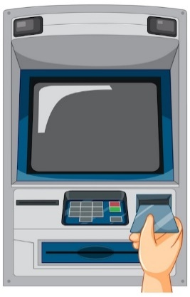
ATM (Automated Teller Machine) Usage
ATMs are among the banking services. ATMs allow people to use their bank accounts 24/7. In order to benefit from ATM services, it is necessary to have a debit card or a credit card of the bank where the account is opened. Many banking transactions such as withdrawing money up to a certain daily limit, paying utility bills such as electricity and water, topping up prepaid phones, depositing money to your own account, paying credit card debt, making money transfers and EFT transactions can be done through ATMs.

Slide 56
Electronic Banking and Considerations
People can carry out banking transactions without going to a bank branch. Bank customers can access their accounts and perform banking transactions from anywhere, using the Internet or telephone, 24 hours a day, 7 days a week. To do this, the person must apply to the bank branch and make his/her account eligible for electronic banking.

Slide 57


Online Banking
Internet banking, also known as online banking, web banking or home banking, allows bank customers to receive banking services over the Internet.

Slide 58

Telephone Banking
Telephone banking is a service provided by a bank or other financial institution that allows customers to perform a range of financial transactions over the telephone without having to go to a bank branch or ATM.

Slide 59
ATTENTION!!!!
The confidentiality of private information and passwords is important in both internet banking and telephone banking. For this reason, private information used in banking transactions should not be shared with anyone.

Slide 60


EDUCATION AND HEALTH FACILITIES

Slide 61

TURKISH EDUCATION SYSTEM
It consists of two main parts: formal education and non-formal education. Formal education is the education given to people of the same age and level in a programmed manner within the school. Formal education consists of pre-school education, primary education, secondary education and higher education institutions. Education is compulsory for all children between the ages of 6 and 17, regardless of nationality. Non-formal education, on the other hand, refers to all the trainings carried out together with or outside formal education..

Slide 62
In order to have the right to education, it is compulsory to be legally present in Türkiye. One of the fundamental principles of the Turkish education system is the principle of universality and equality. The right to education in educational institutions in our country is the right of everyone regardless of language, race, gender and religion. In our country, no person or group is given privilege in education. The right to education is available to everyone and it is a crime to prevent a person from having their right to education.

Slide 63
After the compulsory education, if the person is successful in the exam, he/she is entitled to enroll in a higher education program. The higher education institutions are the educational institutions that provide at least two years of education, and these institutions also aim to train individuals needed in scientific branches. The higher education institutions consist of universities, faculties, institutes, colleges, conservatories, vocational schools and application and research centers.

Slide 64

Higher education includes associate degree programs (2 years), undergraduate programs (4 years), postgraduate programs and doctoral programs.
Associate Degree
Associate degree programs consist of at least two-year programs, which generally give priority to students who have graduated from vocational and technical secondary education and aim to train qualified manpower.
Bachelor’s Degree
Bachelor's degree consists of at least four-year programs based on the student's secondary education achievements. For undergraduate programs, students in Türkiye have to pass a two-stage exam.

Slide 65
Postgraduate
Postgraduate programs are divided into two as postgraduate programs with thesis and postgraduate programs without thesis. After achieving success in the required exams, the student is given the right to enroll. In postgraduate programs with thesis, scientific research methods are taught and it is aimed to reach information with these methods and to use and interpret this information. In postgraduate programs without thesis, it is aimed to gain and apply knowledge on professional subjects in which the person is competent.
Doctorate
Students who meet the conditions and have the necessary qualifications can be accepted to doctoral programs. Accepted students must be successful in the specified exams and studies.

Slide 66
Registration and Acceptance Conditions for Foreign Students to Turkish Schools
Foreign students are obliged to obtain an identity document and an identification number from the Directorate General of Migration Management in order to benefit from schools, education rights and other opportunities in Türkiye. In addition, foreign students must register in the Address Registration System to have the right to enroll and study. Students who have not registered in the Address Registration System can attend classes as ‘guest students’ but are not entitled to receive a diploma.

Slide 67
Entry to Higher Education
The YÖS Examination (Turkish: Yabancı Uyruklu Öğrenci Sınavı) is conducted by The Measuring, Selection and Placement Center (Turkish: Ölçme, Seçme ve Yerleştirme Merkezi, ÖSYM). The universities in Türkiye do not hold their own entrance examinations for foreign students. In order for foreign students to benefit from the right to education and to enter higher education, they must meet the exams, scores and conditions determined by the institutions. The first requirement is that a foreign student must have graduated from a secondary education institution.. A foreign student who wants to enroll in a university in Türkiye must apply to the relevant university with the necessary documents. The relevant university decides whether or not to accept a foreign student. In general, foreign students who want to study in Türkiye should carefully examine and read the title and contents of ‘Those who will receive education with their own means / Those who received a high school education abroad’ on the website of the Council of Higher Education (YÖK).

Slide 68
During the admission of foreign students, the exams that have the status of high-school graduation exams are always considered valid. However, the validity period of the exams, which have the status of university entrance exams, is limited to two years. State universities and foundation universities in Türkiye can demand money from students. The Council of Ministers determines the fees to be paid to state universities, and the boards of the relevant foundation universities determine the fees to be paid to foundation universities.

Slide 69
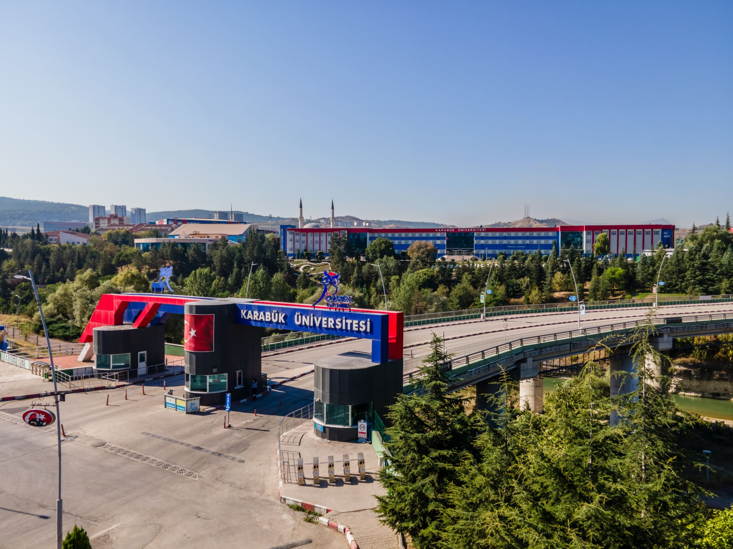
Karabük University, or KBU for short, is a state university founded in 2007. The university bears the name of Karabük, the province where it is located.
Karabük University Iron and Steel Campus is the central campus. The Iron and Steel Campus has many faculties, institutes, research centers, tennis courts, lodgings, dormitories and ATMs. It has also an Olympic swimming pool, a football field, an indoor sports hall, a post office, a branch bank, a botanical garden and a mosque.

Slide 70
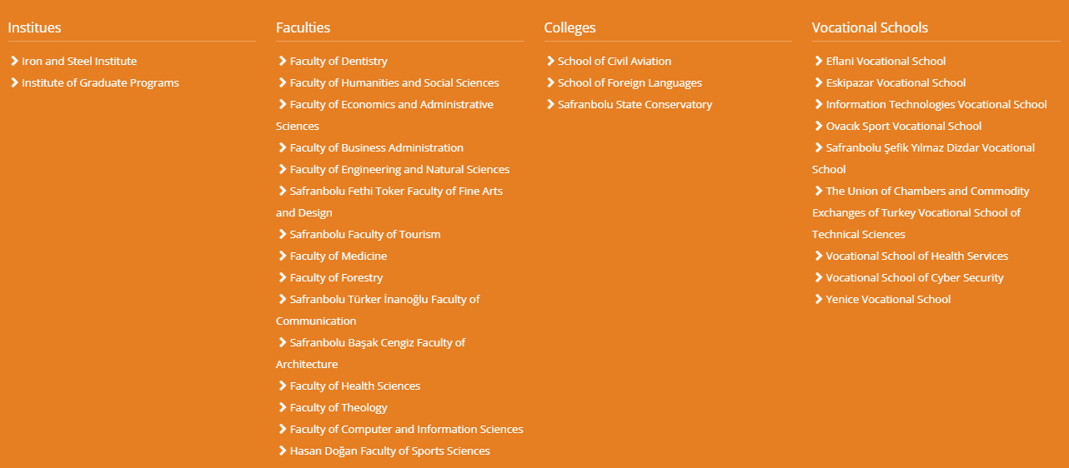
The Academic Units of Karabük University

Slide 71

THE TURKISH HEALTHCARE SYSTEM
The health institutions in the Turkish healthcare system are divided into three levels: primary, secondary and tertiary healthcare institutions.
Primary healthcare institutions: State health centers located in districts, community health centers tuberculosis dispensaries
Secondary healthcare institutions: Public hospitals,
Tertiary healthcare institutions: Training and research hospitals, University hospitals
However, hospitals also have emergency health services for emergencies.

Slide 72

Primary Healthcare Institutions
These health institutions are the institutions where patients without emergencies can receive outpatient treatment. Community health centers and health centers are among these institutions. Foreigners with address registration and residence permit can benefit from these institutions. The patients who cannot be treated in primary healthcare institutions are directed to secondary healthcare institutions. Family health centers, also known as ASMs or community health centers among the public, are primary healthcare institutions generally located in neighborhoods.

Slide 73
Secondary Healthcare Institutions
These health institutions are hospitals where patients are hospitalized and examined and their diseases are identified and treated. Secondary healthcare institutions are the state hospitals that are not training and research hospitals, district polyclinics, oral and dental health centers and the state hospitals in the districts. Some hospitals offer free interpreting services, while others do not. It is generally known that foreign students who do not speak Turkish are likely to go to a hospital with an interpreter. If the diagnosis cannot be established during a treatment or if the patient's treatment requires more detail, the patient is usually referred to tertiary healthcare institutions.

Slide 74
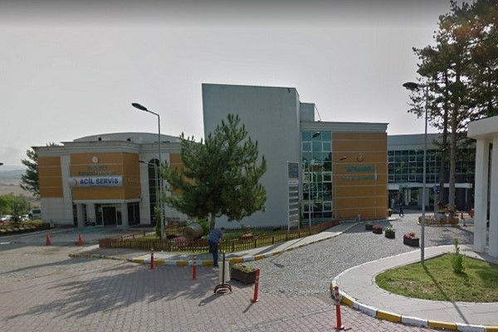
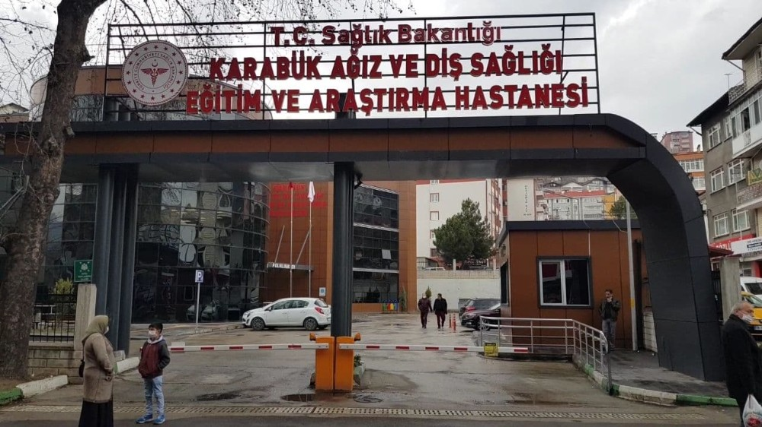
The secondary healthcare institutions in Karabük
The District State Hospital in Safranbolu, Karabük
The Oral and Dental Health Education and Research Hospital in Karabük

Slide 75
Tertiary Healthcare Institutions
Tertiary healthcare institutions are training and research hospitals, university hospitals, university-affiliated medical faculties and district polyclinics. Tertiary healthcare institutions generally provide services to patients whose problems cannot be solved and whose treatments cannot be provided by primary healthcare institutions and secondary healthcare institutions.

Slide 76
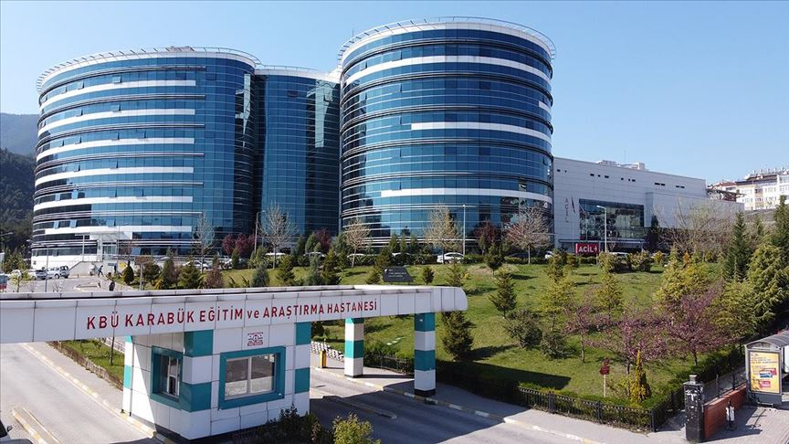
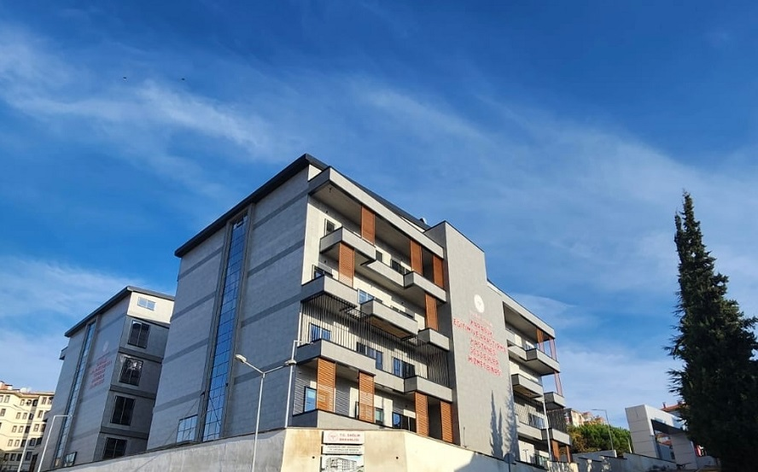
The Tertiary Healthcare Institutions in Karabük
Karabük University Training and Research Hospital
Karabük Training and Research Hospital Beşbinevler Additional Service Building

Slide 77
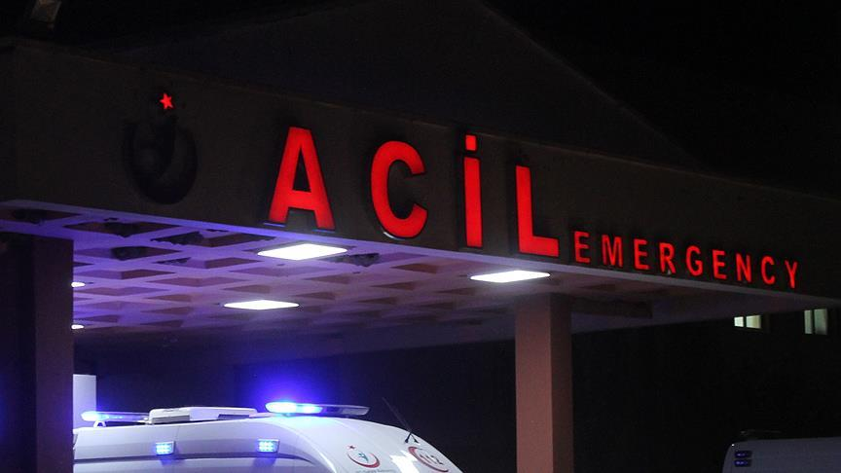
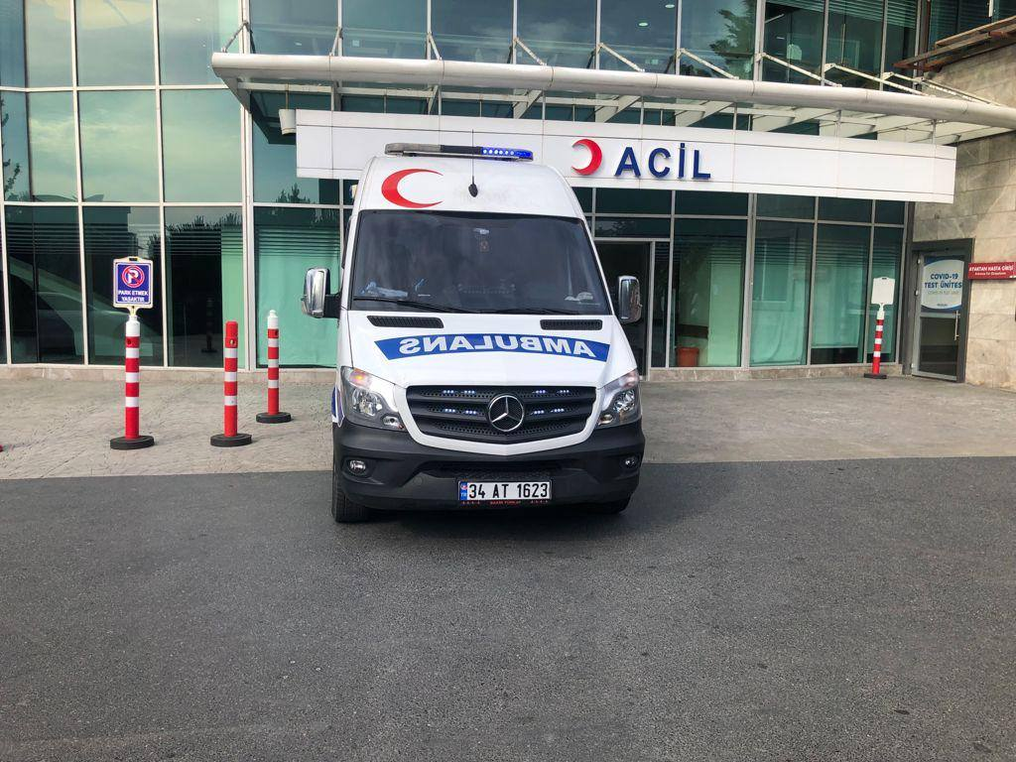
Emergency Health Services
Emergency health services are available 24 hours a day to help citizens in case of any emergency illness or injury. In case of emergency, patients can benefit from the emergency units of hospitals.
112 is an emergency telephone number that patients can reach by telephone (free of charge) at any time of the day in case of illness or injury. In this emergency telephone line, the urgency and location of the person are determined and an ambulance is sent from the nearest hospital to the scene. After the first medical intervention at the scene, the patient is transferred to the hospital.

Slide 78

Making a Hospital Appointment
MHRS (Centralized Physician Appointment System) is a system where citizens can make appointments with hospitals, oral and dental health and family physicians by calling Alo 182, on the web or through the MHRS mobile application. If patients go to hospitals without an appointment, they cannot be examined or wait in line for a long time.
Contact: Alo 182
Web address: : MHRS | Randevu Al

Slide 79

Health Insurance
Foreign students cannot get General Health Insurance (GHI) without an ID number. In order to obtain an ID number, the student must first have private health insurance. After obtaining his/her ID number, he/she can get the compulsory General Health Insurance. If he/she cannot get General Health Insurance (GHI), he/she can benefit from health facilities by getting private health insurance.

Slide 80

Pharmacies and Pharmaceutical Purchasing
Medicines are purchased from pharmacies. Pharmacies are usually located near health facilities. On weekdays they are usually open until the end of the day, while at night and on weekends there are pharmacies on duty. A person who wants to know where the pharmacies are on duty can find out where they are on the internet or from the lists written on the windows of the pharmacies. Some medicines can be bought with a prescription, while others can be bought without a prescription for a fee.

Slide 81
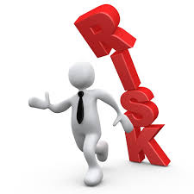
Places to Contact Against Risks
Places and phone numbers to contact in case of any adverse situation:
Whenever there is a need for help, help can be requested by calling the “Emergency Call Center” number 112 from anywhere in Türkiye, free of charge, 24 hours a day, 7 days a week.

Slide 82
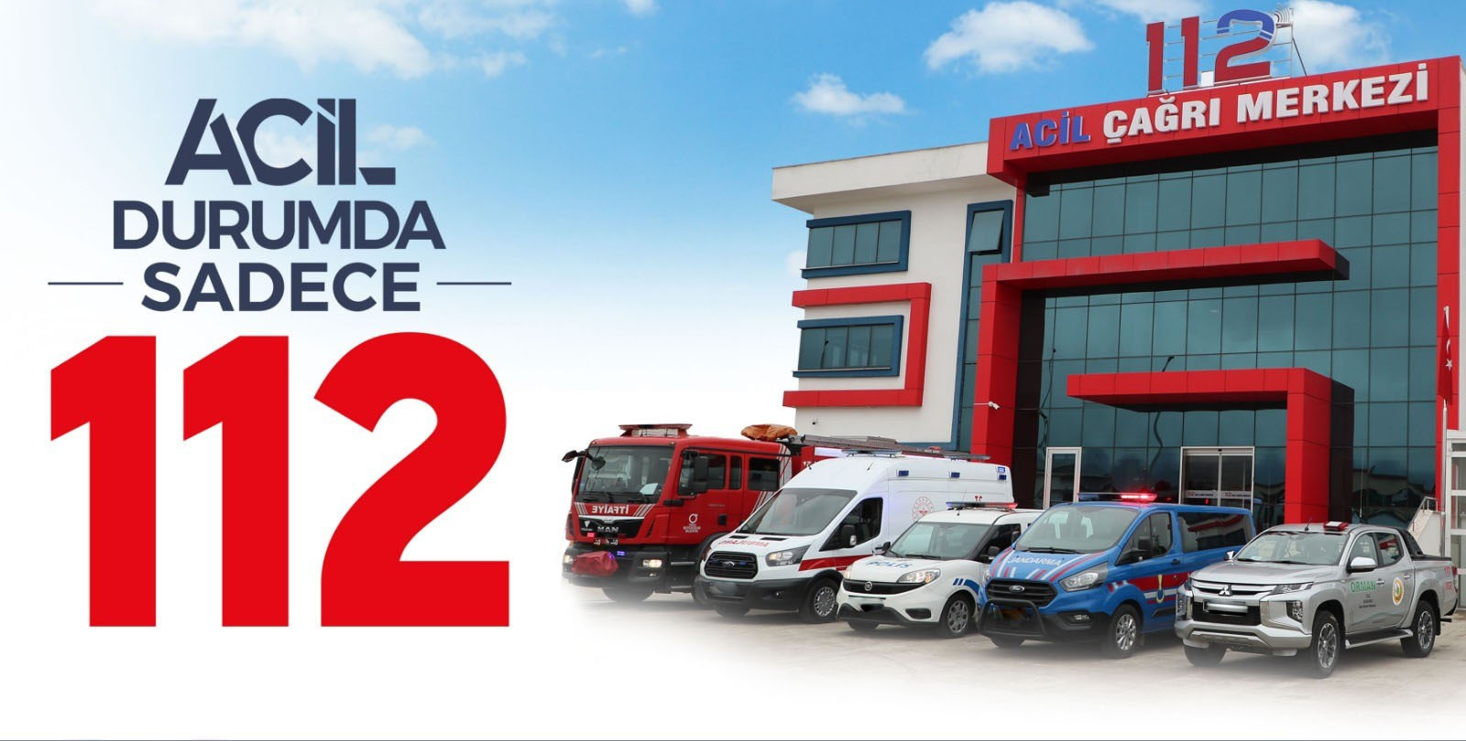
Emergency Call Centers:
Emergency Health Services
Police Stations
Gendarmerie Stations
Fire Brigade

Slide 83
EKİM 2024

